Slide 1
UI PATH – An Overview
RPA

Slide 2
RPA OVERVIEW
> Robotic automation is the application of software to automate tasks and processes otherwise performed by humans. To Simplify, robotic automation is software automating software.
>Software robots can fully automate essential business transactions through Robotic Process Automation (RPA) or optimize the way people work with Robotic Desktop Automation (RDA).
>The goal of robotic automation is an improved customer experience and operational excellence through increased efficiency, performance, and agility in the day-to-day activities across the enterprise.
>What distinguishes RPA from traditional IT automation is RPA software's ability to be aware and adapt to changing circumstances, exceptions and new situations.

Slide 3
UI Path product suite
1. UIPath Studio:
- Designer to build automated processes.
- Powerful Recorder.
Code less and Rich library templates.
2. UIPath Robot:
UiPath Robot executes processes with faultless precision. It can run assisted, automatically executing tasks under your employee’s control and supervision, or unassisted, processing high-volume work independently from human interaction.
3. UIPath Orchestrator:
-Orchestrator manages your entire workforce, handling all the critical enterprise duties: release management, centralized logging, reporting, auditing and monitoring, remote control, workload balancing and asset management.

Slide 4
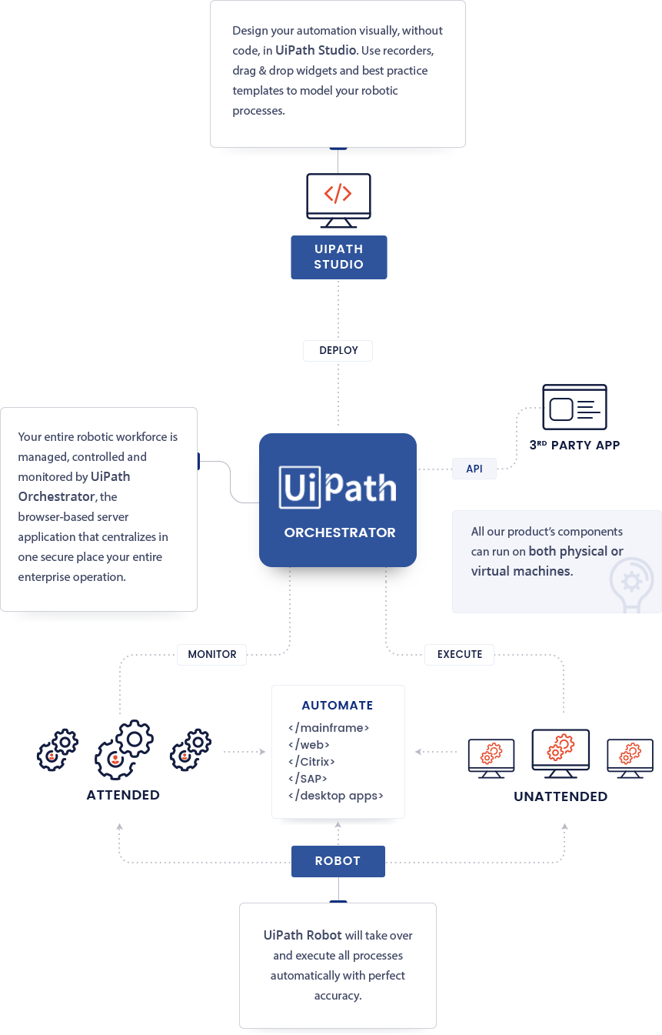

Slide 5
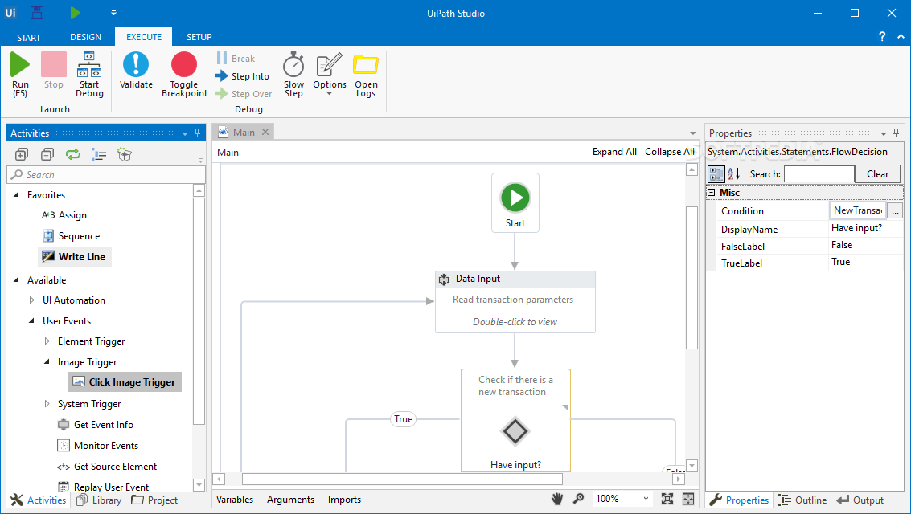
UIPATH Studio
Activities pane
Library pane
Project pane
Main view
Properties pane
Variables |Arguments|Imports
Output

Slide 6
UIPATH | WORKFLOWS
Types:
Sequences:
Flowcharts
State machines
Sequences are the smallest type of workflow. They are suitable to linear processes as they enable you to go from one activity to another seamlessly, and act as a single block activity. One of the key features of sequences is that they can be reused time and again, as a standalone workflow or as part of a state machine or flowchart.
Ex: Create a sequence to take information from a .pdf file and add it to a spreadsheet, and reuse it in a different setting, while changing just a few properties
Flowcharts can be used in a variety of settings, from large jobs to small projects that you can reuse in other workflows.
The most important aspect of flowcharts is that, unlike sequences, they present multiple branching logical operators, that enable you to create complex business processes and connect activities in multiple ways.
A state machine is a type of workflow that uses a finite number of states in its execution. It can go into a state when it is triggered by an activity, and it exits that state when another activity is triggered.
Another important aspect of state machines are transitions, as they also enable you to add conditions based on which to jump from one state to another. These are represented by arrows or branches between states.
There are two activities that are specific to state machines, namely State and Final State, and they are found under Workflow > State Machine.

Slide 7
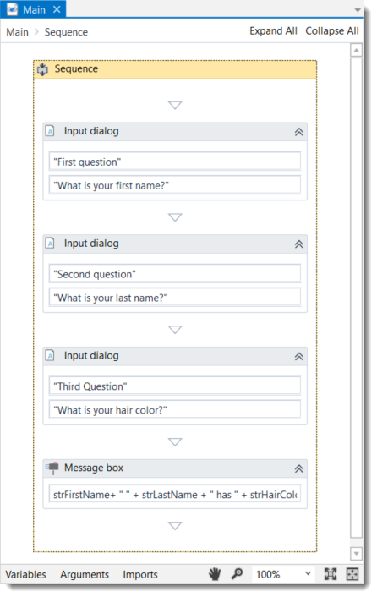
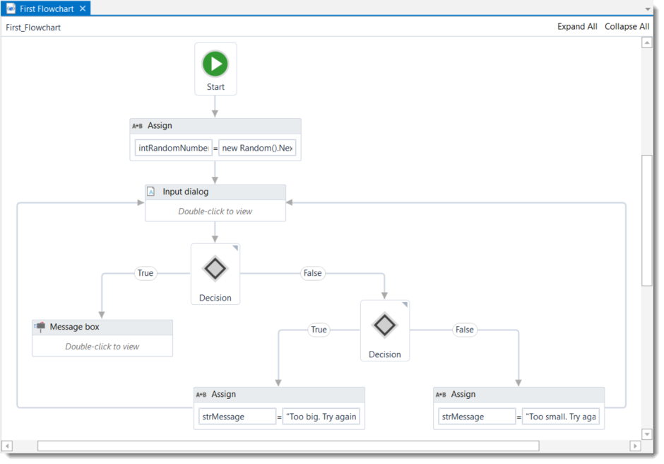

Slide 8
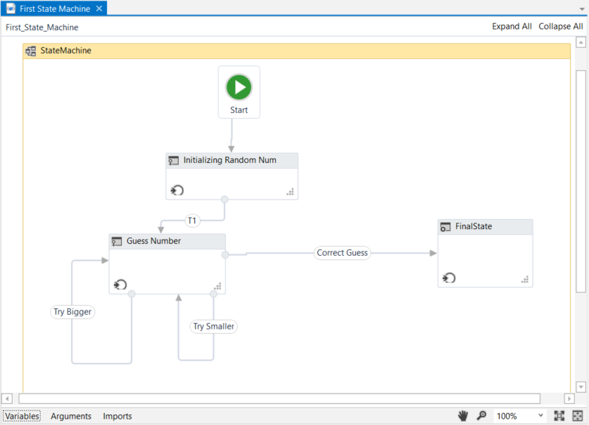

Slide 9
UIpATH Studio | Activities
- Drag and drop + Point and click automation
- Hundreds of Built-in libraries that help automate more tasks faster.
- Some examples of activities supported are:
: Windows /web based application
: Read/write Excel and CSV files
: working with PDF
: Word, XPS, Database, Mail API (SMTP,Outlook etc), Terminals
- Best in Citrix Automation
- Image Recognition engines available(Microsoft, Google and ABBYY)

Slide 10
UIPAth Activities
UI Automation
User Events
App Integration
System
Programming
Workflow
Cognitive
Orchestrator

Slide 11
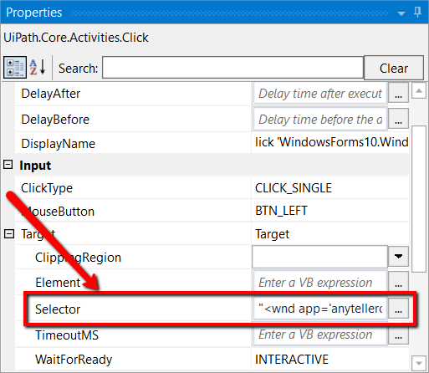
UIPath selectors
UiPath uses what we call selectors. These store the attributes of a graphical user interface element and its parents, in the shape of an XML fragment.
Selectors are stored in the Properties panel of activities, underInput > Target > Selector. All activities related to graphical elements have this property.

Slide 12
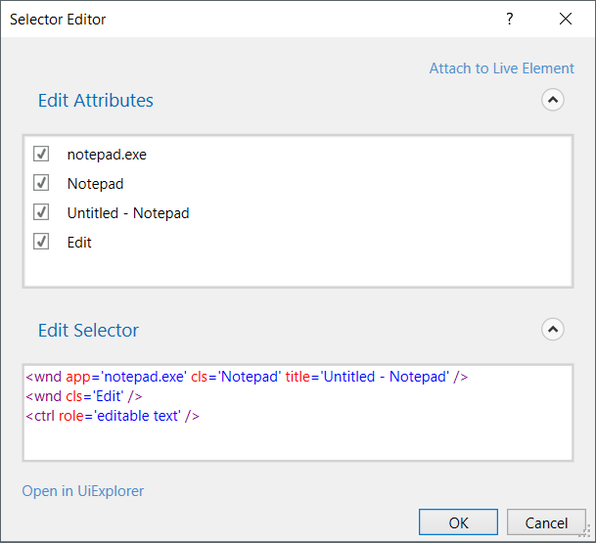

Slide 13
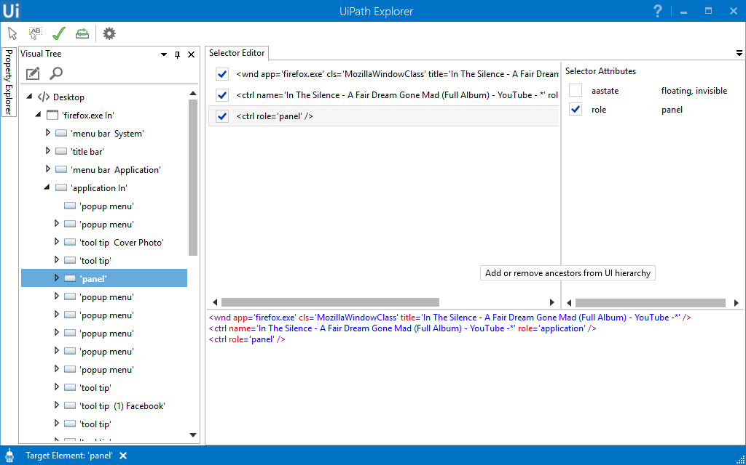
uiPATH EXPLORER
-UIPath Explorer is a tool used to recognize the elements of the active applications.
-UIPath has a unique way of identifying elements.
-UIPath Selectors used can be customized accordingly by modifying the attribute values.

Slide 14
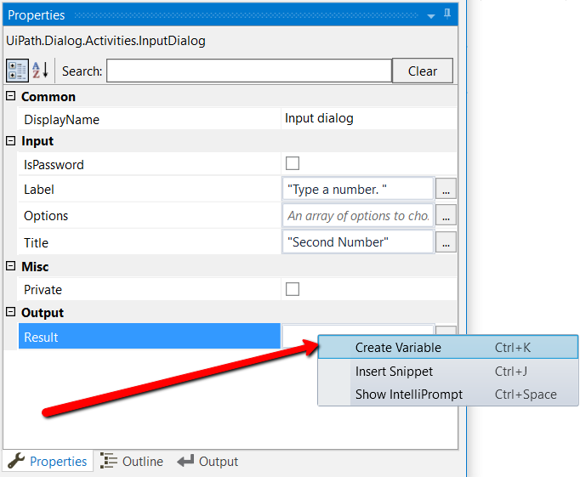
UIPATH VARIABLES
In UiPath Studio, variables are used to store multiples type of data. Another key aspect of variables is that their value can change so that you can, for example, control how many times the body of a loop is executed.
The data stored within a variable is called a value, and it can be of multiple types. In UiPath, we support a large amount of types, ranging from generic value, text, number, data table, time and date, to UiElements.

Slide 15
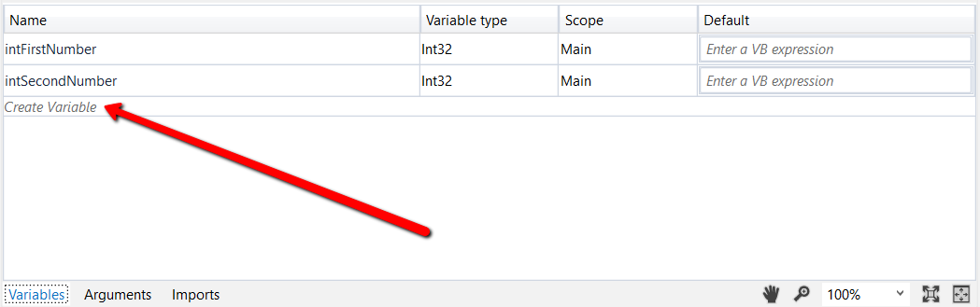
From the Variables panel:
In the Main panel, click Variables. The Variables panel is displayed.
Click the Create Variable line. A new variable with the default values in displayed.
Promoting Variables to Global Scope
Some variables, when created directly in an activity (from the context menu of an activity), are automatically given the smallest scope they belong to. To make them available in your entire workflow, do the following:
Click the smallest container in a workflow.
On the Design ribbon tab, in the Variables group, select Manage Variables > Promote to Global Scope. All the variables used in the selected container now have a global scope.

Slide 16
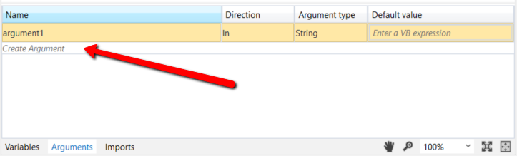
ARGUMENTS
Arguments are used to pass data from a workflow to another. In a global sense, they resemble variables, as they store data dynamically and pass it on. Variables pass it to other activities, while arguments pass it to other workflows. As a result, they enable you to reuse workflows time and again
Due to the nature of arguments, you are going to use them a lot in relation with the Invoke Workflow File and Launch Workflow Interactive activities. They can be found in the Activities panel, under Workflow > Invoke and they enable you to browse for a workflow, and import and edit their arguments..

Slide 17
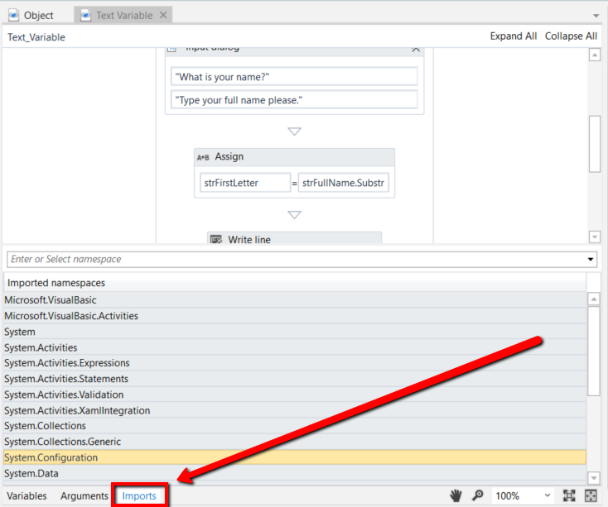
Imported NAMESPACES
VB.Net namespaces in UiPath Studio represent containers that store different types of data. They enable you to define the scope of your expressions, variables and arguments.
For example, if you have the System.Data namespace imported, you can further use DataTable, DataView, DataColumn, DataRowand other classes that are available in it, without having to always type System.Data.DataTable and so on.
All imported namespaces are displayed in the Imports panel. Note that some namespaces are automatically imported when you browse for a .Net type variable or argument, for example.
To open this panel, click Imports in the Main panel.

Slide 18
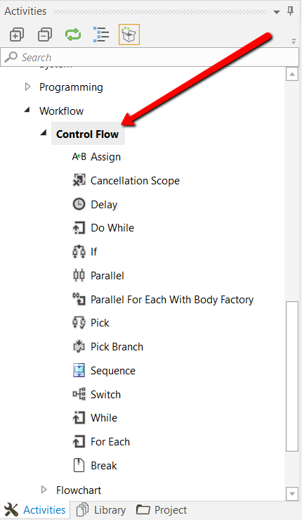
CONTROL FLOW
All of these activities can be found in the Activities panel, under Workflow > Control Flow.
They enable you to define rules and automate decisions for a given workflow, through if…else or for each statements or loops, as well as add delays so that you can perfectly time two activities.
Loops represent an important part of workflows as they enable you to easily check dependencies between variables, activities and conditions. They are created once and enable you to iterate data a specified number of times, until a condition is met, once for each item in a collection or indefinitely.

Slide 19
Uipath reCORDING
Recording is an important part of UiPath Studio, that can help you save a lot of time when automating your business processes. This functionality enables you to easily capture a user’s actions on the screen and translates them into sequences
Recordable | Non-recordable
Left-click on buttons, check boxes, drop-down lists and other GUI elements Text typing | Keyboard shortcuts Modifier keys Right-click Mouse hover
Regardless of the type of recording selected, some actions are recordable and some are not.

Slide 20
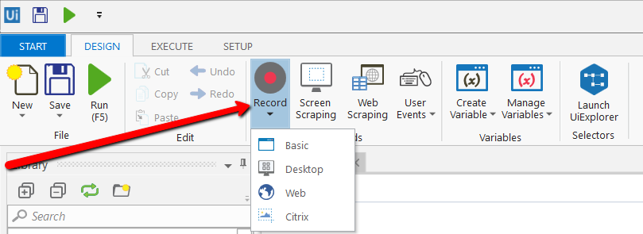
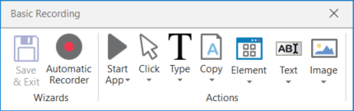
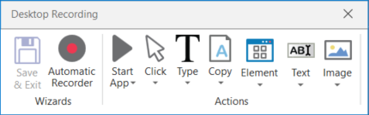
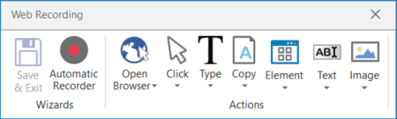
RECORDING TYPES
Basic – generates a full selector for each activity and no container, the resulted workflow is slower than one that uses containers and is suitable for single activities.
Desktop – suitable for all types of desktop apps and multiple actions; it is faster than the Basic recorder, and generates a container (with the selector of the top level window) in which activities are enclosed, and partial selectors for each activity.
Web – designed for recording in web apps and browsers (supported: Internet Explorer, Google Chrome), generates containers and uses the Simulate Type/Click input method by default.
Citrix – used to record virtualized environments (VNC, virtual machines, Citrix, etc.) or SAP, permits only image, text and keyboard automation, and requires explicit positioning.

Slide 21
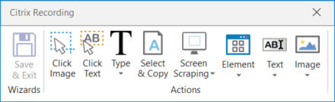
Citrix recording
To figure out if you should use automatic or manual recording in your workflow, you should better understand the differences
between them and their capabilities.
Automatic Recorder | Manual Recorder
Left-clicks on windows, buttons, check boxes, drop-down lists etc. Text typing | Keyboard shortcuts Modifier keys Right-click Mouse hover Getting text Find elements and images Copy to Clipboard

Slide 22
UI ELEMENTS
UI elements refer to all graphical user interface pieces that construct an application, be they windows, check boxes, text fields or drop-down lists, and so on. Knowing how to interact with them enables you to implement UI automation much faster and easier.
Input Methods and Output or Screen Scraping Methods.
Input Actions | Output Actions
Clicks Text Typing Keyboard shortcuts Right-clicks Mouse hover Clipboard actions Etc. | Getting text Finding elements and images Clipboard actions Etc.

Slide 23
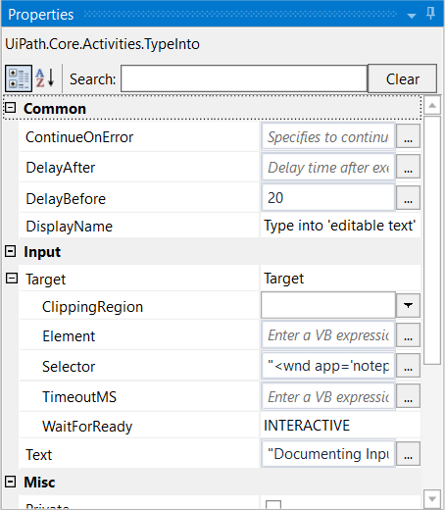
UI ELEMENT PROPERTIES
ContinueOnError – specifies if the workflow should continue, even if the activity throws an error. This field only supports boolean values (True, False).
DelayAfter – adds a pause after the activity, in milliseconds.
DelayBefore – adds a pause before the activity, in milliseconds.
TimeoutMS – specifies the amount of time (in milliseconds) to wait for a specified element to be found before an error is thrown. The default value is 30000 milliseconds (30 seconds).
WaitForReady – wait for the target to become ready, before performing the activity. There are three available options:
None – does not wait for the target to be ready.
Interactive – waits until only a part of the app is loaded.
Complete – waits for the entire app to be loaded.
Target – identifies the UI element the activity works with.

Slide 24
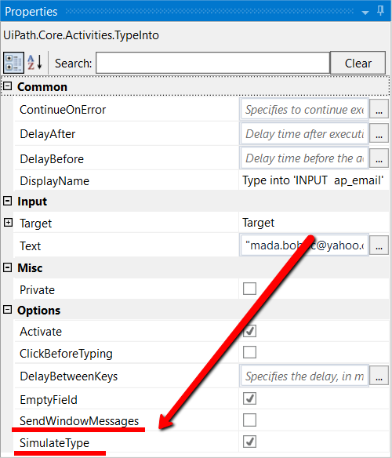
INPUT METHODS
Input actions require you or the robot to directly interact with an opened application or web page. There are three types of input methods for click and type actions, that differ in terms of compatibility and capability. We generally recommend the Simulate Type/Click method as it is the fastest of the three and works in the background, but only if you do not need to send special keyboard shortcuts. If this does not work for you, try the Windows Messages method and then the Default one, as it is the slowest.
Method\Capability | Compatibility | Background execution | Speed | Hotkey Support | Auto Empty Field
Default | 100% | no | 50% | yes | no
Window Messages | 80% | yes | 50% | yes | no
Simulate Type/Click | 99% - web apps 60% - desktop apps | yes | 100% | no | yes

Slide 25
OUTPUT METHODS
FullText is the default method, it is fast and accurate, yet unlike the Native method, it cannot extract the screen coordinates of the text.
Output or screen scraping methods refer to those activities that enable you to extract data from a specified UI element or document, such as a .pdf file.
To understand which one is better for automating your business process, let’s see the differences between them.
OCR:
1. Google
2.Microsoft
Method\Capability | Speed | Accuracy | Background Execution | Extract Text Position | Extract Hidden Text | Support for Citrix
FullText | 10/10 | 100% | yes | no | yes | no
Native | 8/10 | 100% | no | yes | no | no
OCR | 3/10 | 98% | no | yes | no | yes

Slide 26
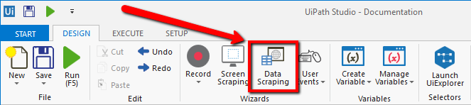
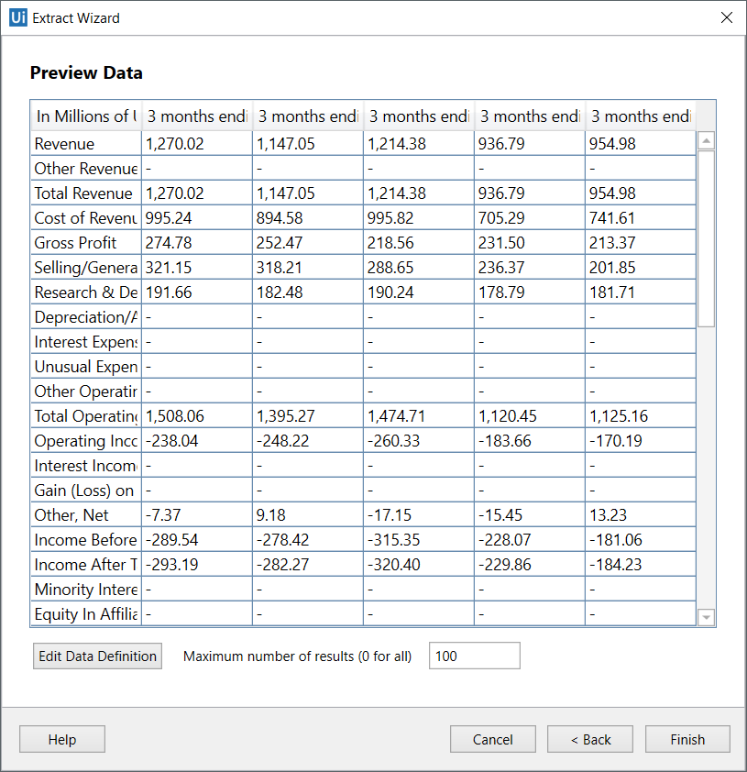
DATA SCRAPING
Data scraping enables you to extract structured data from your browser to a database, .csv file or even Excel spreadsheet.
Structured data is a specific kind of information that is highly organized and is presented in a predictable pattern. For example, all Google search results have the same structure (a link at the top, a string of the URL and a description of the web page), which enables Studio to easily extract the information, as it always knows where to find it.
The scraping wizard can be opened from the Design tab, by clicking the Data Scraping button

Slide 27
IMAGE & TEXT AUTOMATION
To enable image and text-based process automation, UiPath Studio features activities that simulate keyboard and mouse input, such as clicking, hovering or typing, text recognition and OCR activities that use screen scraping to identify UI elements, and image recognition activities that work directly with images to identify UI elements. Specialized recording wizards for Screen Scraping and Citrix recording can also automatically generate the activities required for each process.
Image and Text automation is useful in situations when UI automation does not work, such as in virtual machine environments, where selectors cannot be found by using normal methods.

Slide 28
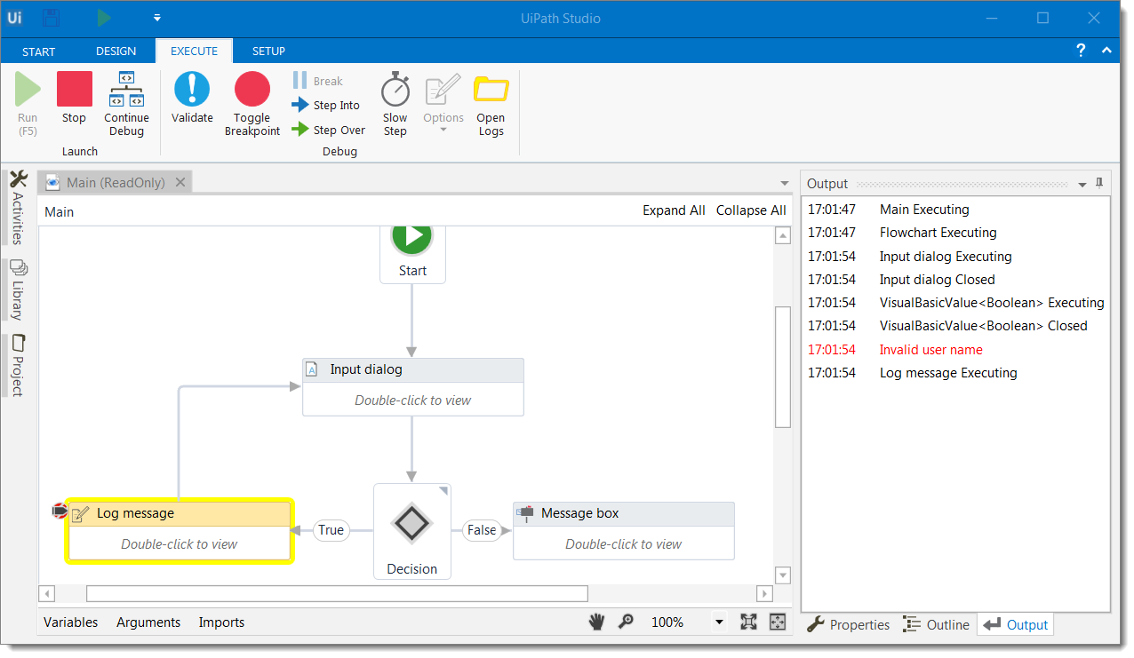
debugging
Debugging is the process of identifying and removing errors from a given workflow. Coupled with logging and breakpoints, it becomes a powerful functionality that offers you information about your project and step-by-step highlighting, so that you can be sure it is error-free.

Slide 29
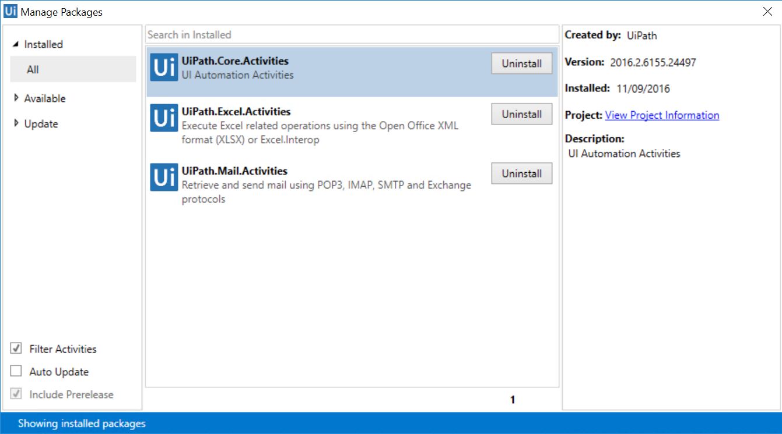
MANAGING PACKAGES
The package manager functionality enables you to download activity packages, libraries, frameworks, wrappers and others, view the ones already installed on your computer and update them, as well as add and remove your own.
These features are available through the Manage Packages window that you can open by clicking the Manage Packages button on the Activities panel.

Slide 30
RELEASES
UiPath v2017.1
UiPath v2016.2
UiPath v2016.1

Slide 31
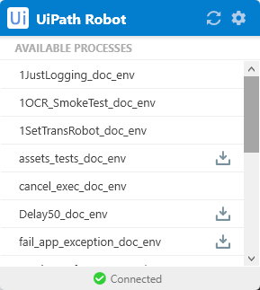

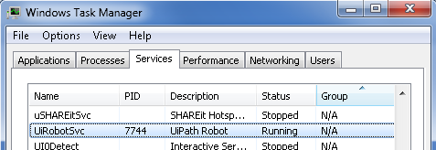
UIPAth robot
Types of Robots:
1. Attended
2. Unattended
3. Free
The UiPath Robot tray enables you to:
1. View all the available automation processes
2. Start processes
3. View the running process and stop them, as in the following screenshot
The Robot is UiPath’s execution agent that enables you to execute automation projects built in Studio.
A Robot is installed as a Windows Service by default. As a result, the Robot can open Windows sessions (interactive or non-interactive), and has all the rights of a Windows service.

Slide 32
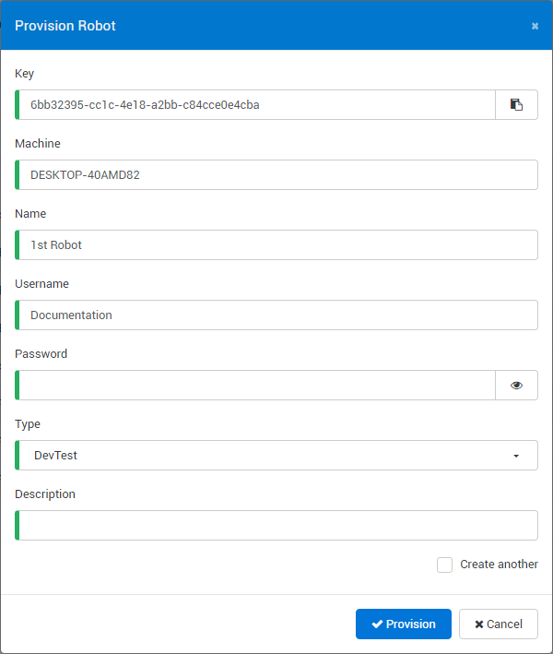
ROBOT <------------>Orchestrator
1. From the Orchestrator and Robot Settings window
2. From the command line
3. Using the Connection String

Slide 33
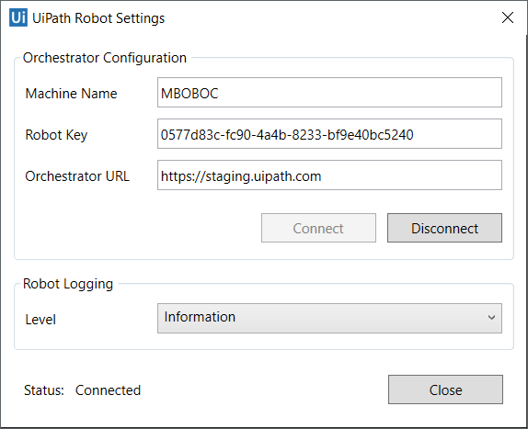
Uipath robot settings
Deploy the Robot to Orchestrator
On the Robot machine, do the following:
In the system tray, click the UiPath Robot icon. The UiPath Robot window is displayed.
Click Advanced > Settings. The Settings window is displayed.

Slide 34
ORCHESTRATOR
UiPath Orchestrator is a web application that enables you to organize your UiPath Robots in executing repetitive business processes.
Orchestrator lets you manage the creation, monitoring, and deployment of resources in your environment, acting in the same as an integration point with third party solutions and applications
Orchestrator Main Capabilities
Provisioning creates and maintains the connection between Robots and web application
Deployment - assures the correct delivery of the package versions to the assigned Robots for execution
Configuration - maintains and delivers Robot environments and processes configuration
Queues - ensures the queues and queue items management
Monitoring - keeps track of Robot identification data and maintains user permissions
Logging - stores and indexes the logs to an SQL database and/or ElasticSearch (depending on your architecture and configuration)
Inter-connectivity - acts as the centralized point of communication for 3rd party solutions or applications

Slide 35
Concepts of uipath orchestrator
users→ Robots, Users
Roles→ Administrator, Robot
Robots
Environments
Packages
Processes
Assets
Queues & Transactions
Jobs
Schedules
Alerts
Logs
Audit

Slide 36
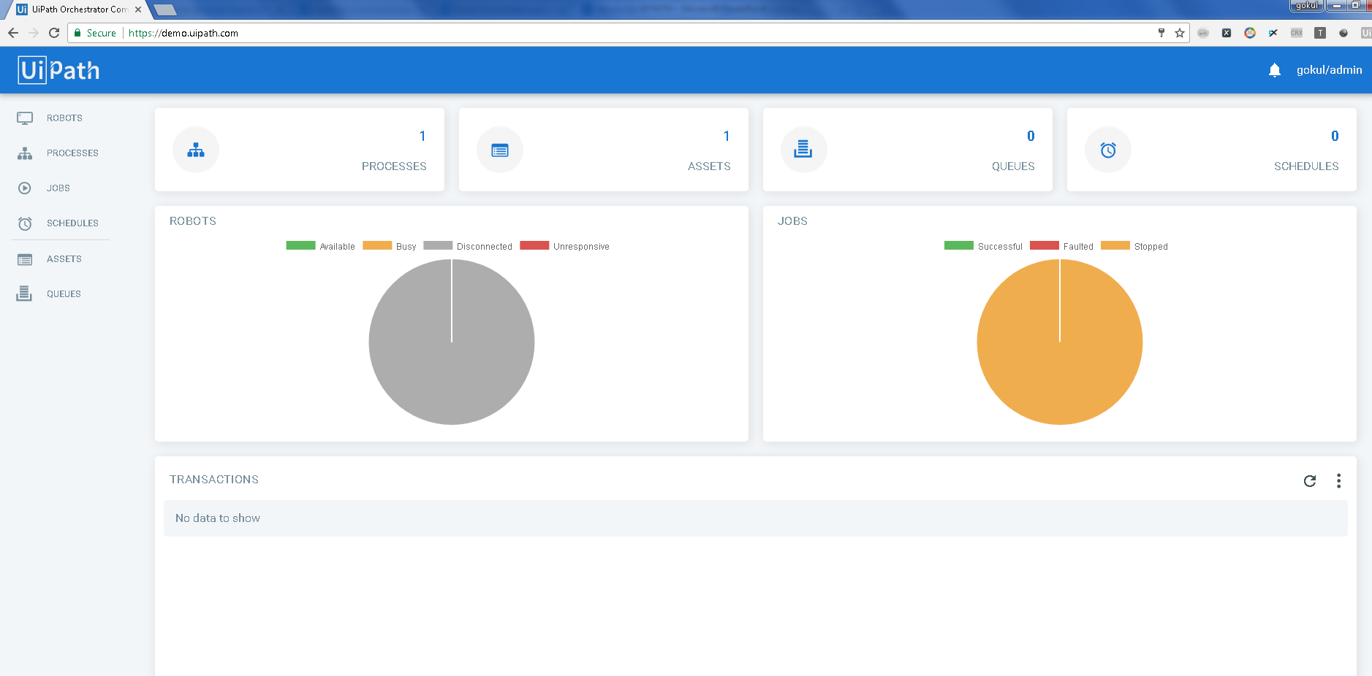

Slide 37
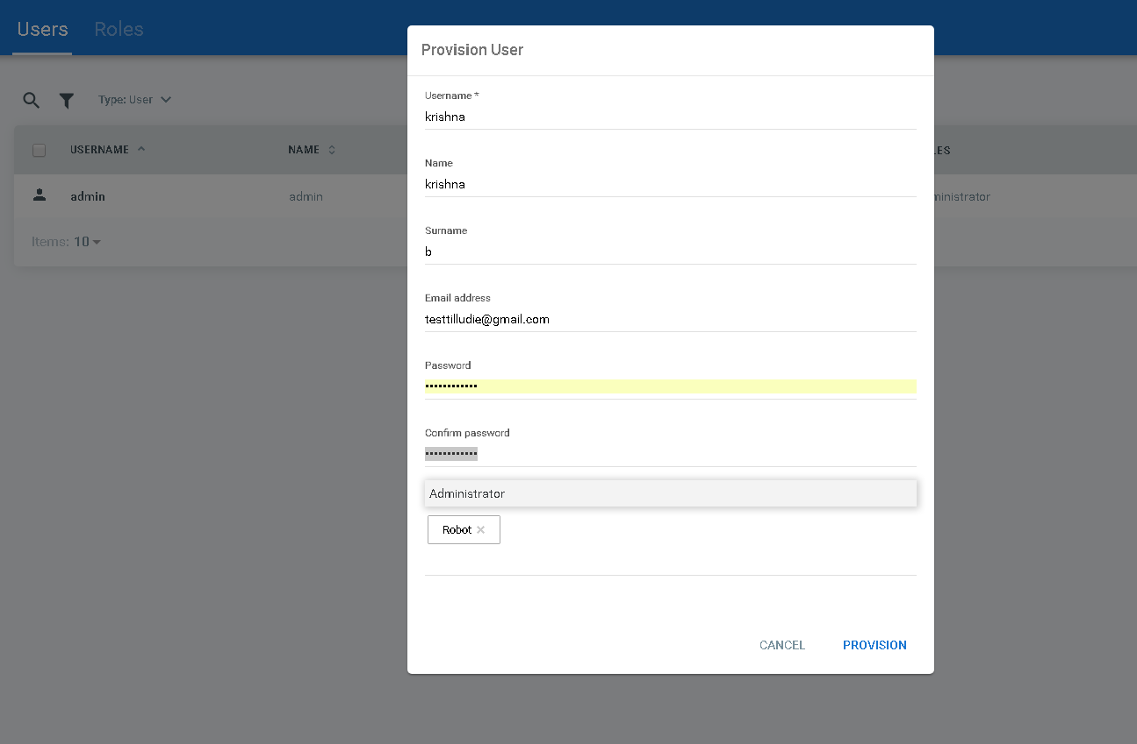
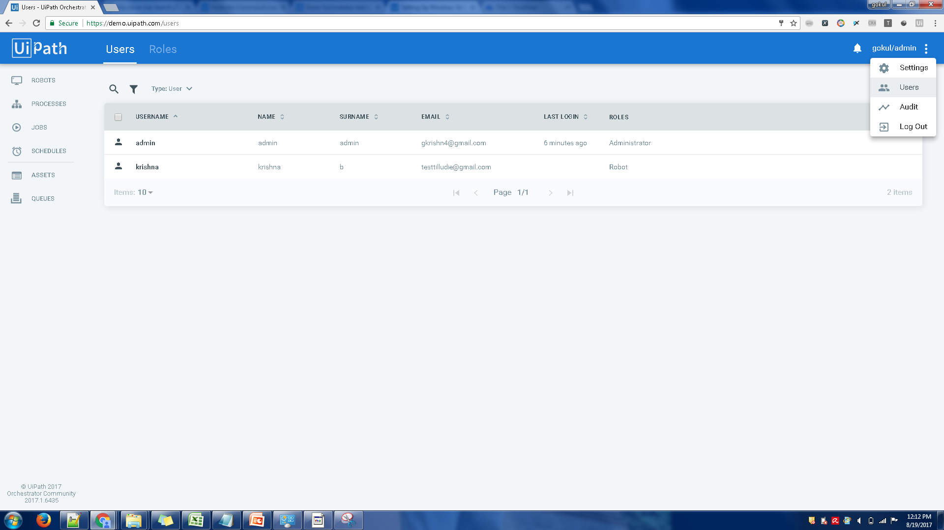
USERS
A user is an entity that stores the assigned role(s), email settings and enables you to login to Orchestrator. A user’s view of Orchestrator is dependent on the assigned roles.
There are two types of users: Robot and User. The Robot user is automatically created when you deploy a Robot to Orchestrator, with the Robot role.

Slide 38
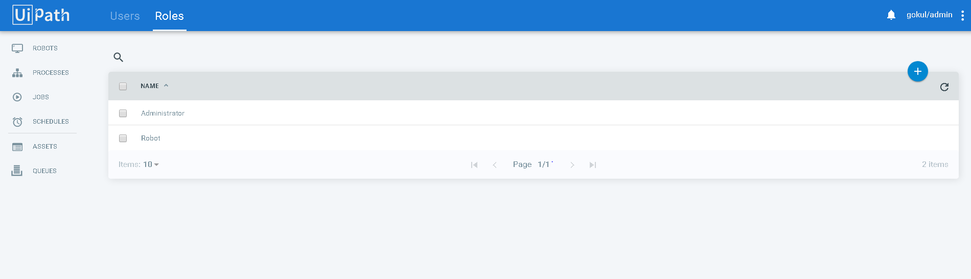
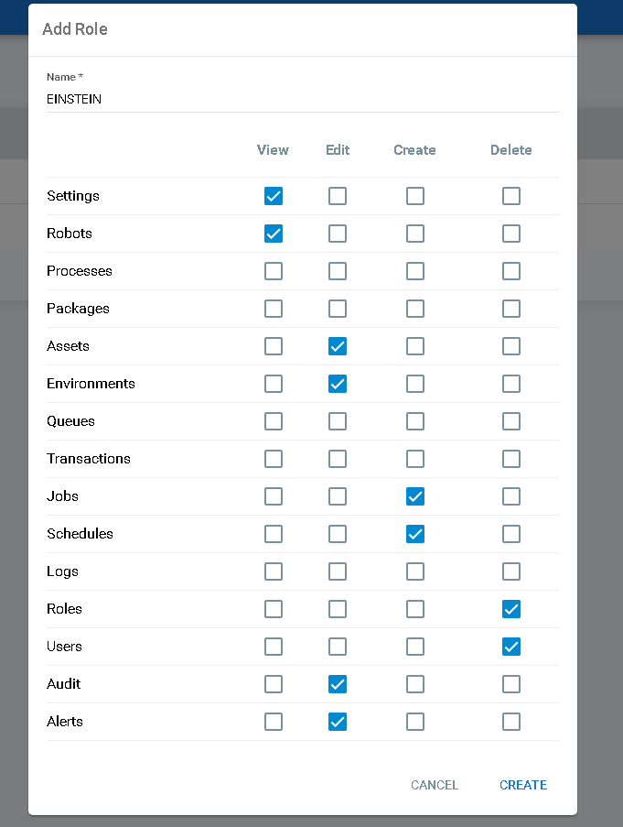
ROLES
The Roles page enables you to manage user permissions in Orchestrator. A user’s view of Orchestrator is dependant on the role(s) assigned to it.
By default, only the Administrator and Robot roles exist. They cannot be changed or removed.

Slide 39
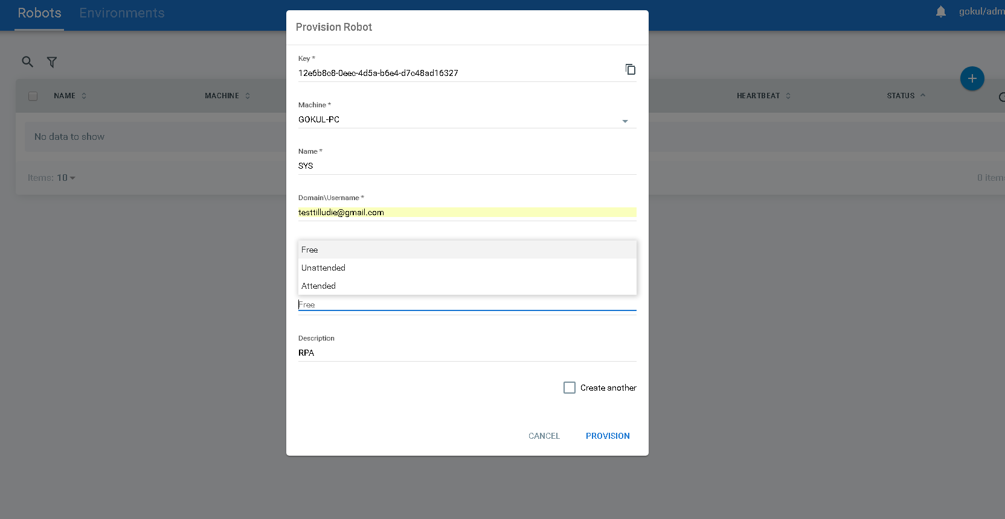
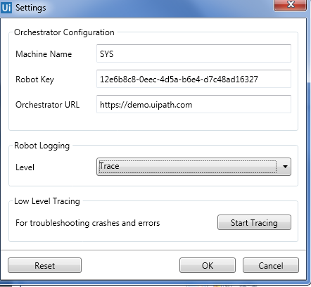
PROVISION ROBOT

Slide 40
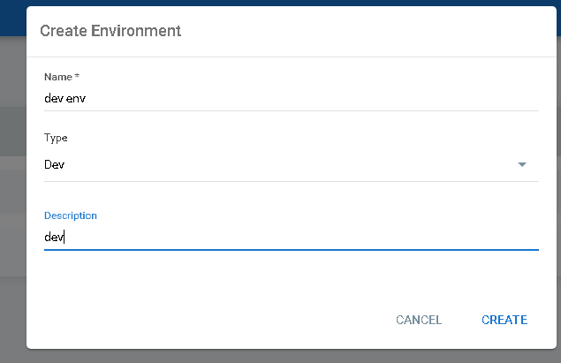
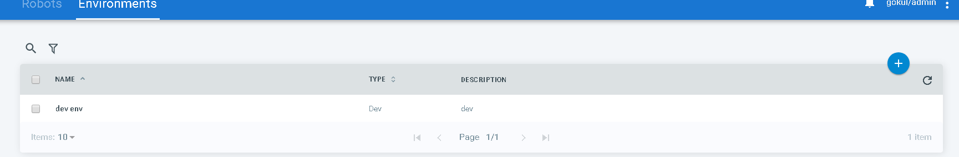
eNVIRONMENTS
An environment is a grouping of Robots, that is used to deploy processes.
Multiple types of environments are available in UiPath. The types are used to help your automation team know how the Robot environments should be used, as follows:
Dev - for development purposes;
Test - for testing what the development team has created;
Prod - in production, after an automation project has passed all the necessary tests.

Slide 41
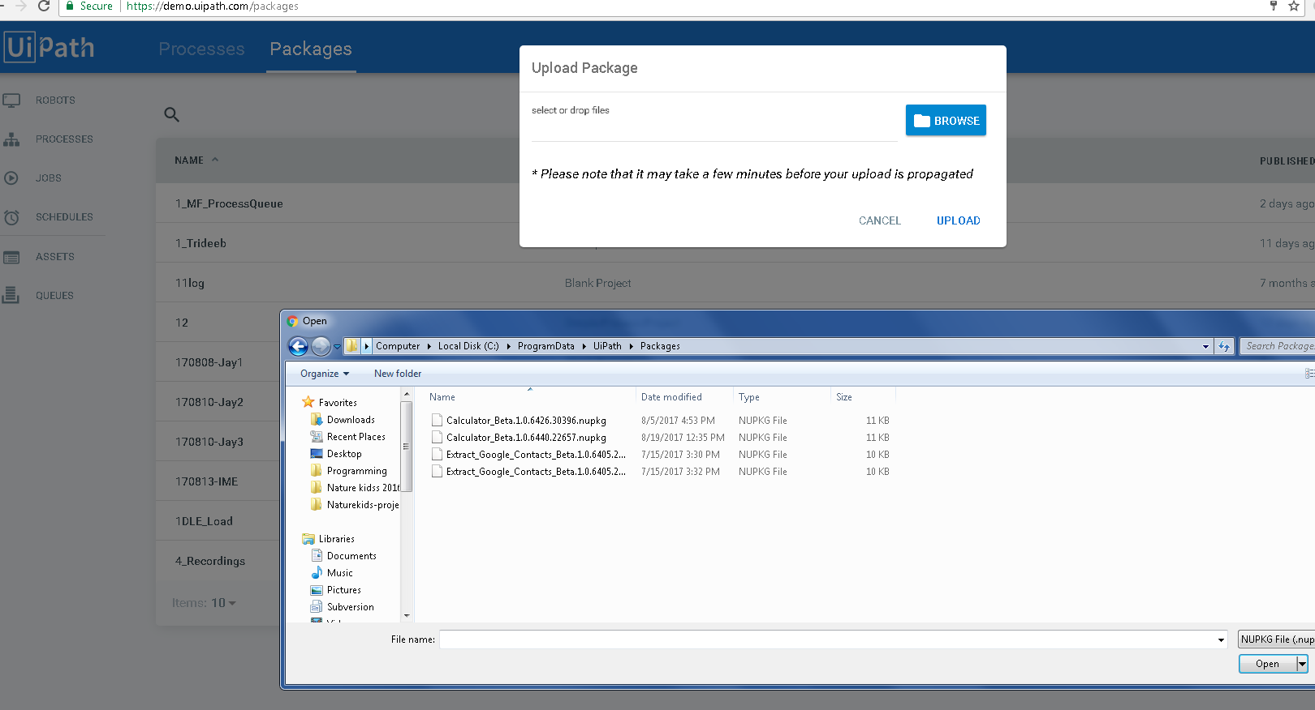
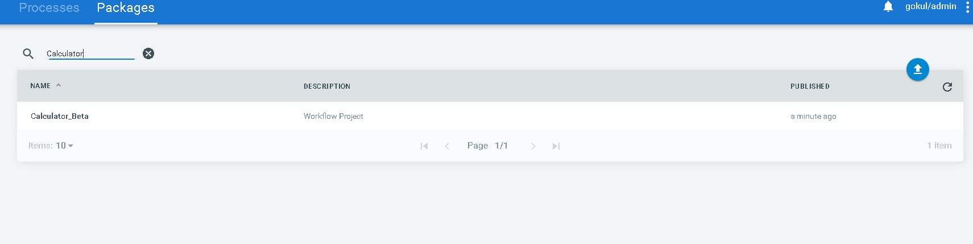
PACKAGES
The Packages page displays all the projects published from UiPath Studio, as well as the ones that were manually uploaded. For more information, see Publishing a Project from Studio to Orchestrator.

Slide 42
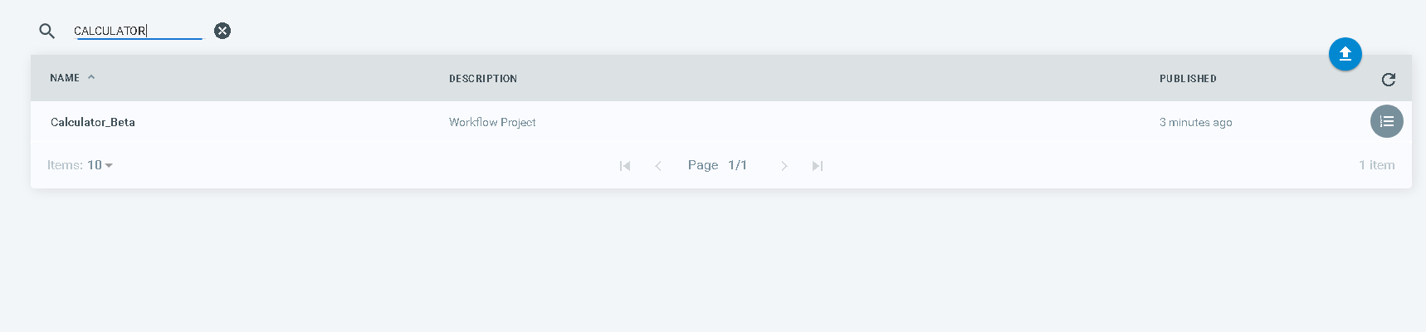
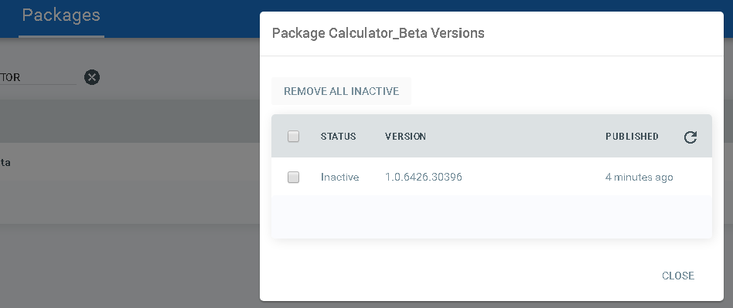

Slide 43
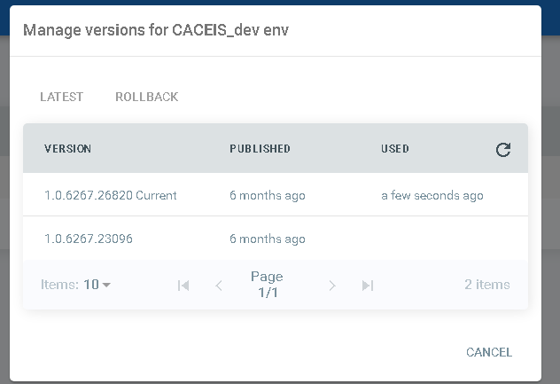
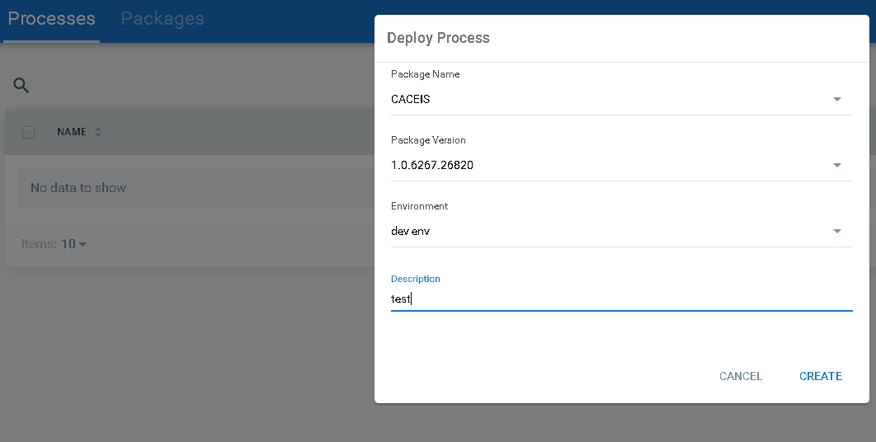
PROCESSES
The Processes page enables you to deploy an uploaded package to Robot environments, manage previously created associations and keep all your processes up to date. This helps you distribute packaged on the Robot machines and execute processes faster from the Jobs page.

Slide 44
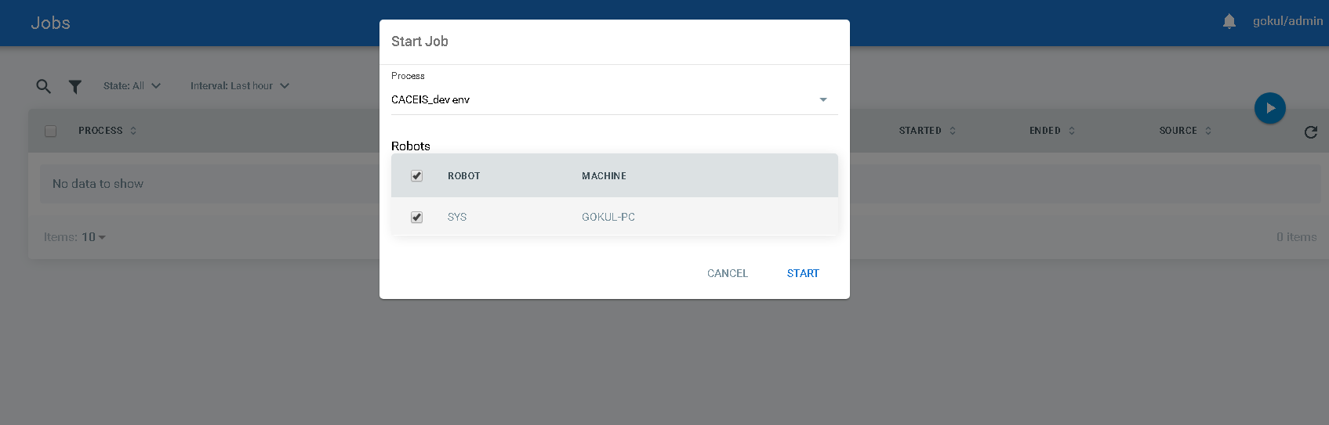
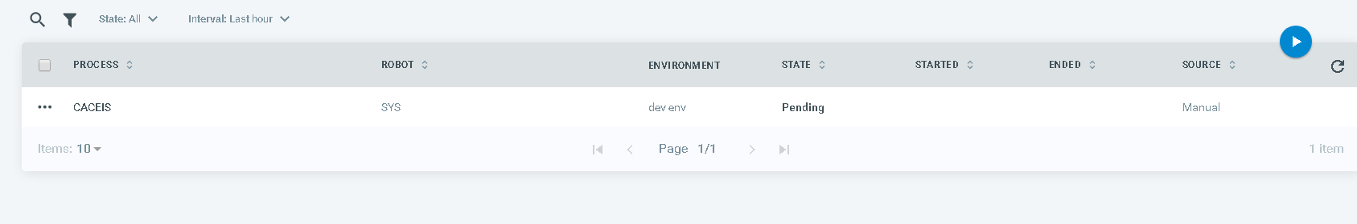
JOBS
A job is the execution of a process on one or multiple Robots. After creating a process (deploying a package to an environment), the next step is to execute it with the assigned Robots. This can be done manually from the Jobs page or in a preplanned manner, from the Schedules page.

Slide 45
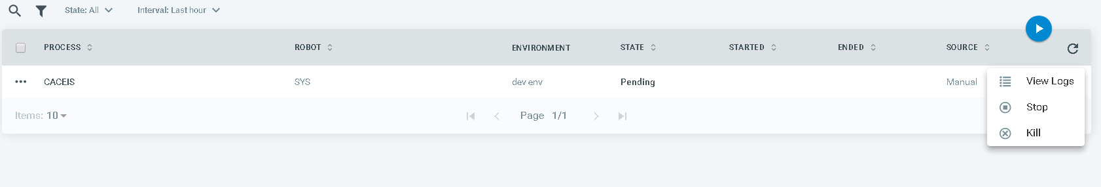
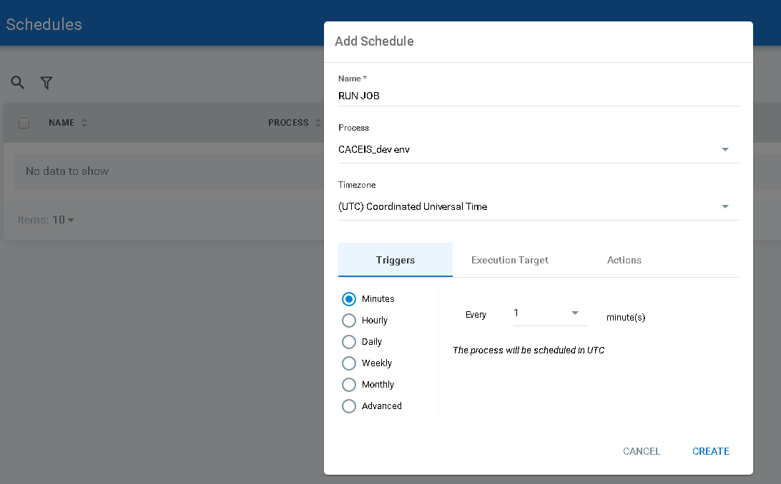
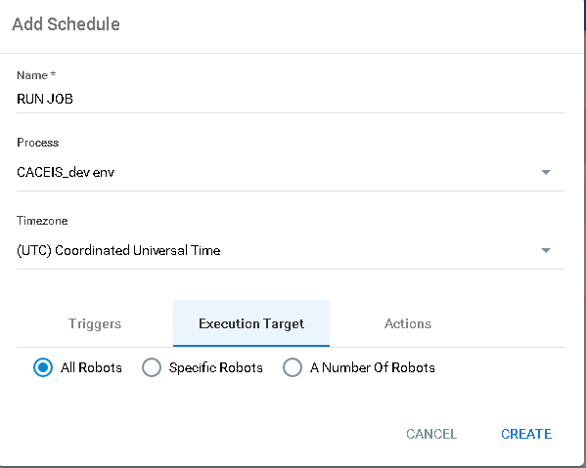
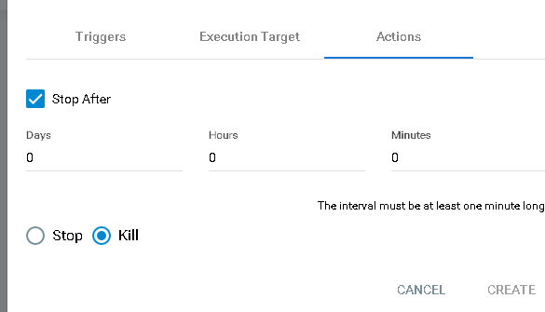

Slide 46
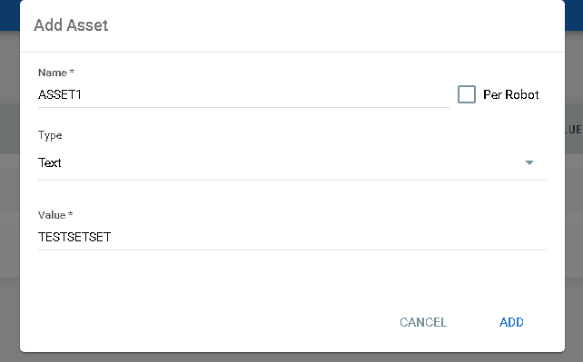

ASSETS
Assets usually represent shared variables or credentials that can be used in different automation projects. They give you the opportunity to store specific information so that the Robots can easily have access to it

Slide 47


QUEUES
A queue is a container that enables you to hold an unlimited number of items. Queue items can store multiple types of data, such as invoice information or customer details. This information can be processed in other systems - SAP or Salesforce, for instance.
New queues created in Orchestrator are empty by default. To populate queues with items, to change their status and process them, you have to use Studio activities. As soon as queue items are processed, they become transactions.

Slide 48


ALERTS
The Alerts page displays notifications for Robots, queue items, schedules, and jobs. The notifications appear in real time and have the following severity levels: Info, Success, Warn, Error and Fatal.

Slide 49

LOGS
The Logs page displays logs generated by Robots. To make it easier to sift through all the generated data, you can view it in a filtered manner, as follows:
all logs generated by an indicated Robot, from the Robots page
all logs generated by a Robot within an indicated job, from the Jobs page
Messages are logged on the following levels: Trace, Debug, Info, Warn, Error and Fatal.
Custom messages can also be sent to this page from Studio, with the Log Message activity. The messages can be logged at all the levels described above and should be used for diagnostic purposes.

Slide 50


AUDIT
The Audit page displays the audit trail for actions performed by all entities in Orchestrator.

Slide 51
RPA | UIPath Roles in the industry
> QA Software Engineer
> Robotic Process Automation consultant
> Robotic Process Developer
> .Net Developer

Slide 52
UiPath Academy Certification Program
1. RPA Developer Foundation Diploma
free of charge to those who have successfully completed the RPA Developer Foundation Training, through our massive open online courses platform.
The Final Test for the beginner-level diploma is comprised of 45 questions, with no time limit. Candidates must score a minimum of 70% to pass the test.
The RPA Developer Foundation Diploma acknowledges that the graduate has attained basic knowledge about the UiPath components, features, and technology, is familiar with UiPath methods of automating business processes and is qualified for enrolling in the RPA Developer Advanced Training.
2. RPA Developer Advanced Certification
The RPA Developer Advanced Certification is available to candidates with strong programming skills, who are expected to fulfill the role of RPA Developer, RPA Service Support or RPA Solution Architect in the future RPA Centre of Excellence.
The enrollment in the Certification exam can be done through your company RPA Sponsor. The exam is instructor-led and is organized into 2 parts:
the first part consists of an online quiz, with a 70% passing score; the second part is a practical webinar conducted by one of our RPA Experts, where passing score is 70%.
Only those candidates who have already passed the online quiz will be eligible for the practical examination. The RPA Developer Advanced Certification attests that the graduate has attained in-depth knowledge about the UiPath components, features, and technology, has successfully automated a real life project based on UiPath best practices and automation principles, and is now qualified to fulfill any of the key technical roles such as RPA Developer, RPA Solution Architect or RPA Service Support within an RPA Center of Excellence.
Certification Fee: There is a certification fee applied by the individual user. Please contact our Sales department for the pricing model available for this certification.

Slide 53
Thank you

